Slide 1

DATA VISUALIZATION

Slide 2
Agenda
01
02
03
04
05
Objective
Dataset
Process
Insights
Recommendations

Slide 3
Objective
To analyze the online retail data for the following.
Identify High-Demand Regions for Online Sales
Understand Regional Buying Patterns
Support Targeted Expansion Strategy
Drive Informed Decision-Making

Slide 4
Dataset
The Online Retail Sales Dataset contains the following columns.
Invoice No | Stock Code
Description | Quantity
Invoice Date | Unit Price
Customer ID | Country
For the analysis, the new column is added.
Revenue

Slide 5
Process
Developed a comprehensive understanding of the online retail dataset, sales volume, product categories, geographic distribution, and customer segments.
Prepare the data for accurate analysis by handling inconsistencies and noise.
Create a structured framework for analysis and insights generation.
Extract actionable insights from the data using visualization techniques.

Slide 6
Insights
Revenue by Month 2011
Top 10 Countries by Revenue and their Quantity
Top 10 Customers by Revenue
Revenue by Countries

Slide 7
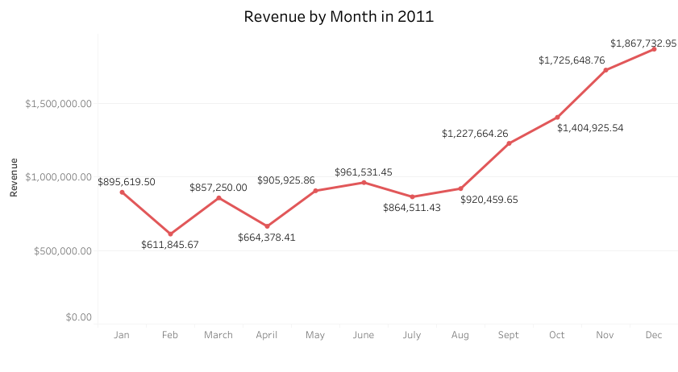
Revenue by Month 2011
Revenue shows steady growth from August onwards, with a sharp increase in the final quarter. This trend may indicate increased customer demand during the holiday season.
October, November, and December show substantial revenue gains, peaking at $1.87 million in December. This seasonal peak could be leveraged with special campaigns in the future.

Slide 8
Insights for Future Planning
Demand Forecasting
Use revenue trends to better plan inventory and meet expected demand throughout the year.
Marketing Opportunities
Focus promotions during high-demand months and use engagement campaigns to boost sales during slower periods.

Slide 9
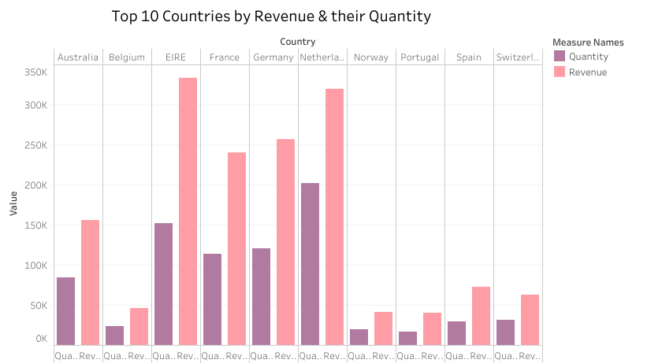
Top 10 Countries by Revenue & their Quantity
EIRE, Germany, and the Netherlands have strong demand and high sales. Australia and France show high revenue but lower quantity, which may indicate higher-priced products.
Norway and Spain have both lower revenue and quantity, suggesting areas with room for growth.

Slide 10
Insights for Future Planning
Focus on High-Value Markets
Prioritize growth in countries with high revenue and quantity, like EIRE, Germany, and the Netherlands.
Boost Low-Performing Markets
Consider strategies like local promotions to increase sales in countries with lower demand, like Norway and Spain.

Slide 11
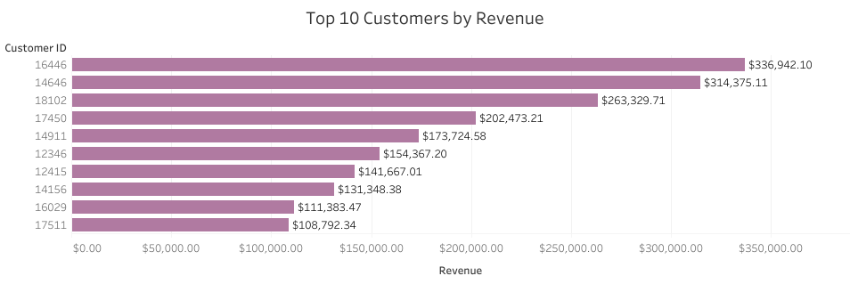
Top 10 Customers by Revenue
The chart highlights the top 10 customers, with the highest revenue generated by Customer ID.
A majority of revenue comes from a few top customers, indicating a strong dependence on key clients.

Slide 12
Insights for Future Planning
Strengthen Top Relationships
Focus on retaining and expanding sales with top customers through loyalty programs or exclusive offers.
Diversify Customer Base
Develop strategies to grow revenue from lower-tier customers to reduce dependence on a few high-revenue clients.

Slide 13
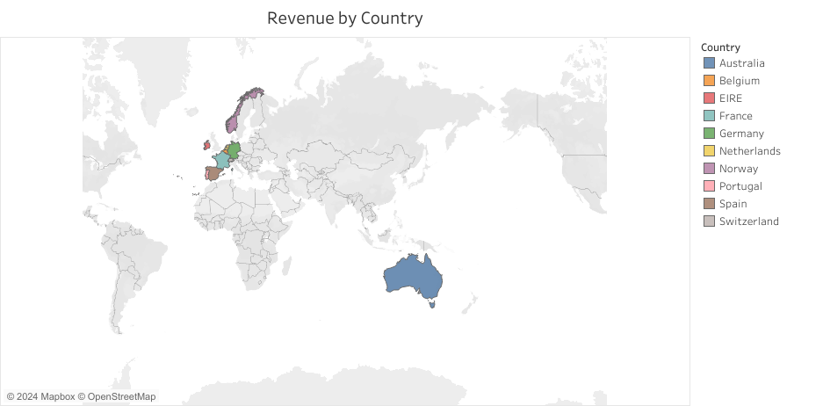
Revenue by Countries
Visualizes revenue distribution across countries, highlighting top-performing regions..
Countries like Australia, Germany, and EIRE show significant contributions, while others like Norway and Spain have lower revenue.

Slide 14
Insights for Future Planning
Target High Revenue Regions
Focus on strengthening operations and marketing in high-revenue countries.
Explore Growth Opportunities
Investigate strategies to boost performance in underperforming regions like Norway and Spain.

Slide 15
Recommendations
Focus on High-Performing Markets
Prioritize investment and expansion in top-revenue regions like Germany, EIRE, and Australia to capitalize on strong demand.
Boost Underperforming Regions
Implement targeted marketing and localized strategies in low-revenue regions such as Norway and Spain to increase sales.
Diversify Customer Base
Reduce reliance on top customers by nurturing relationships with mid-tier clients and incentivizing smaller buyers to grow their contributions.

Slide 16
Thank You…! Any Questions…?

